Slide 1
BRAZILIAN ECONOMY
Student Name
Institutional Affiliation
Course
Date

Slide 2
Introduction
Brazil is the biggest economy in the continent of South America
Brazil has strong agricultural, mining, manufacturing, and service sectors. It has the strongest economy in South America
The world’s ninth largest economy and seventh largest purchasing power parity

Slide 3
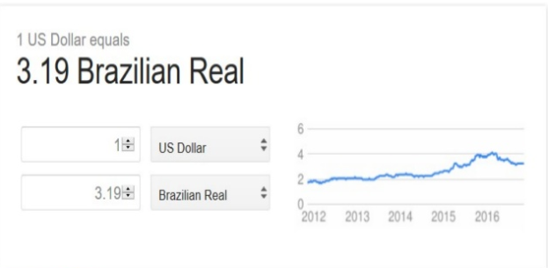
USD vs. Brazilian Real

Slide 4
How Geopolitics affect Brazil’s International Trade
Geopolitics
Study of the relationships between demography, economics, environment, geography, and politics and how they influence countries foreign and national security policies.
Brazil had a population close to 199.5 million people and the life expectancy for both men and women is 71 years and 77 years respectively
The main exports of Brazil are coffee beans, iron ore, oranges among other agricultural produce

Slide 5
Brazil’s Economic Indicators
GDP
Inflation
Exports and Imports
Unemployment
Interest Rates
Income

Slide 6
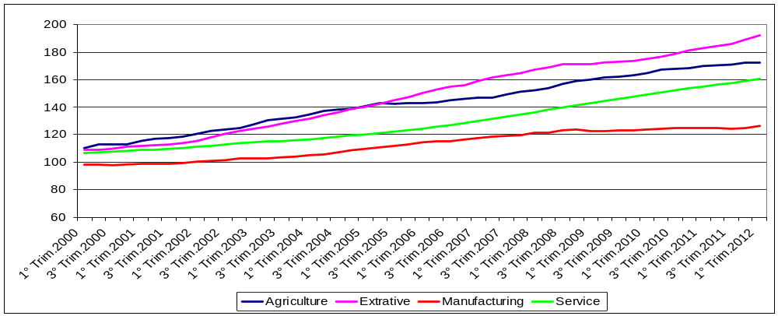
Gross Domestic Product per Sector

Slide 7
GDP
It is ranked 8th in the world
Brazil has the highest GDP in Latin America
The GDP per capita (value of goods and services produced per person) is $12,100

Slide 8

Inflation
The inflation rate increased slightly, reaching 3.8 percent compared to 3.3 percent in 2017 and is anticipated to reach 4.3 percent by the end of 2019

Slide 9
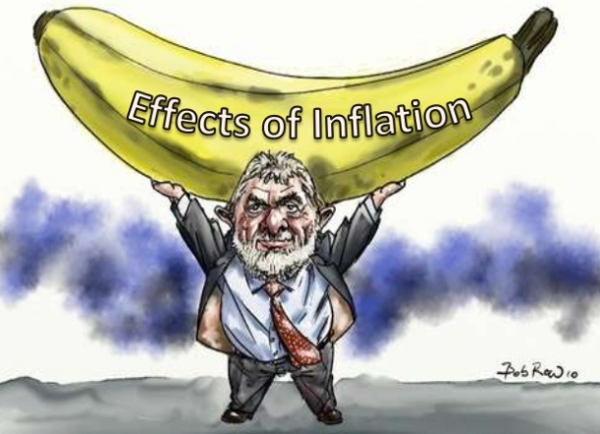
Inflation

Slide 10
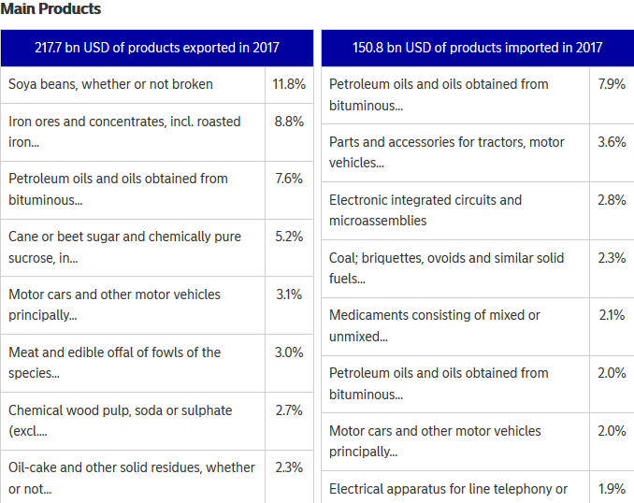
Exports and Imports(2017)

Slide 11
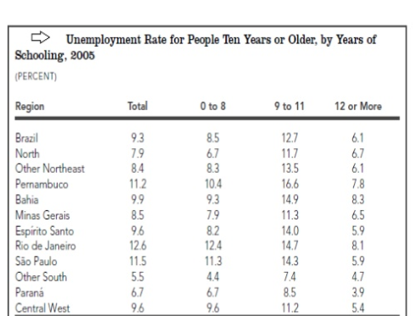
Unemployment

Slide 12
Brazil’s Main Industry Sectors
Agriculture
Mineral and metallurgy
Service sector
Tourism

Slide 13
Agriculture
Brazil is largest producer of soybeans, oranges, sugar cane and coffee
The agricultural sector contributes 4.6 percent of GDP
Employs roughly 10 percent of the total Brazilian population
Represents approximately 40 percent of the country’s exports

Slide 14
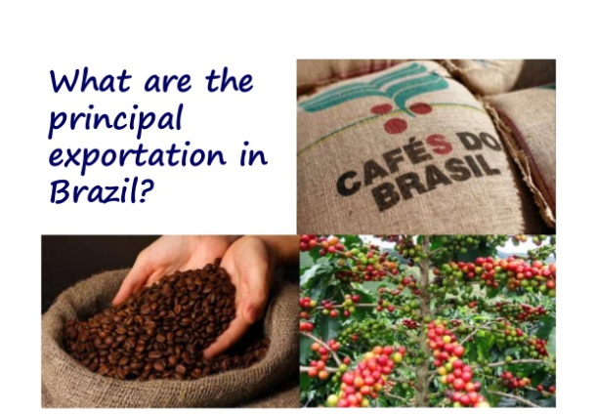
Agriculture

Slide 15
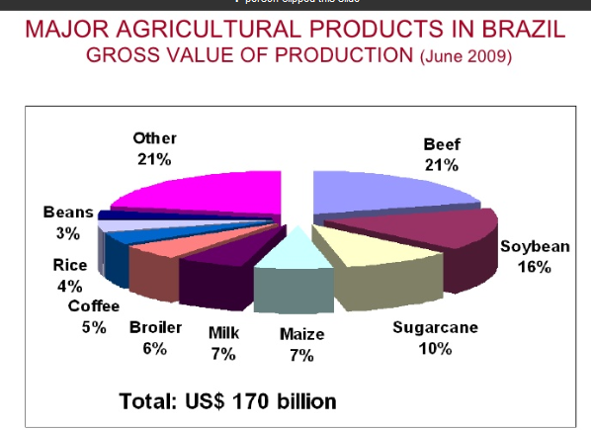
Agriculture

Slide 16
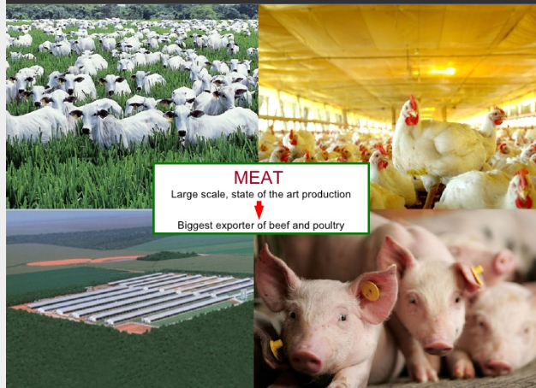
Agriculture

Slide 17
Opportunities Brazil Provides for U.S.A
Brazil provides opportunities for the United State investors in agricultural technology and innovation to make agricultural production more efficient

Slide 18
References
Bear, W. (2008). The Brazilian economy: growth and development. (6, Ed.) Boulder; Rienner.
The World Factbook. (2013). Washington,DC. Retrieved from Central Intelligence Agency: https://www.cia.gov/library/publications/download/download-2013/index.html
FAOSTAT. (2014). Food and Agriculture Organization of the United Nations. Retrieved from http://faostat.fao.org
International Monetary Fund.,(2018). World Economic Outlook, October 2018: Challenges to Steady Growth. International Monetary Fund,2018.
USDA. (2013). Economic Research Service. Retrieved from International Agricultural Productivity: http://www.ers.usda.gov/data-products/international-agricultural-productivity.aspx#.UsVs67SzSJQ

